Slide 1


Accreditation Canada International (ACI)
Prepared by: NHC ACI Champions

Slide 2
What is ACI?
Accreditation Canada is an organization that provides assessment programs for health and social service organizations to improve the quality of health and social services.
We use ACI standards as tools to ensure that our standard of healthcare delivery is optimum.
ACI surveys are assessments of our organization’s practices and commitment to quality and patient safety.

Slide 3
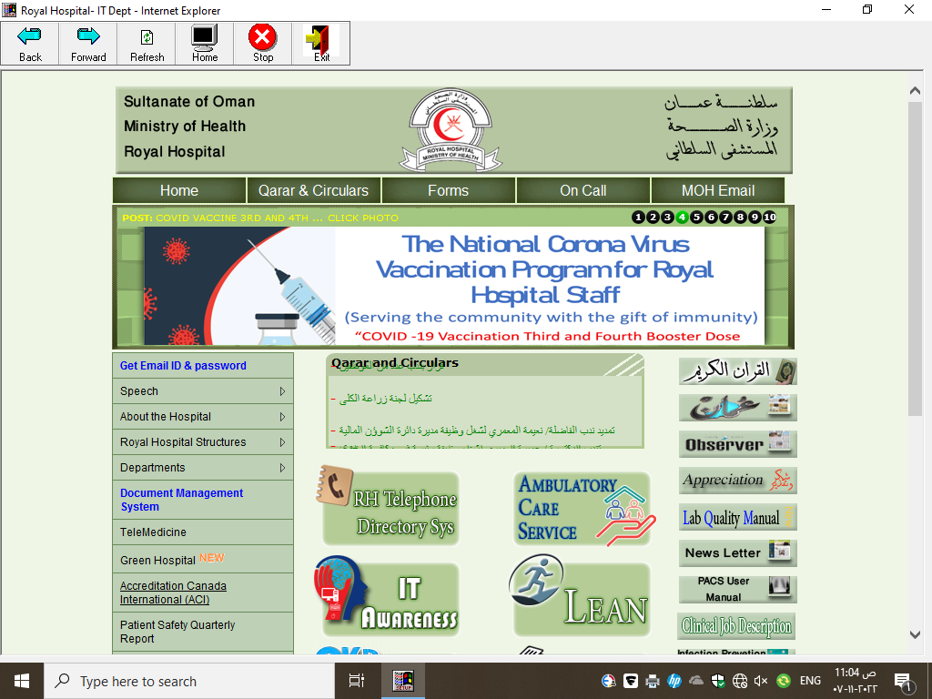
Where can the standards be found?

Slide 4
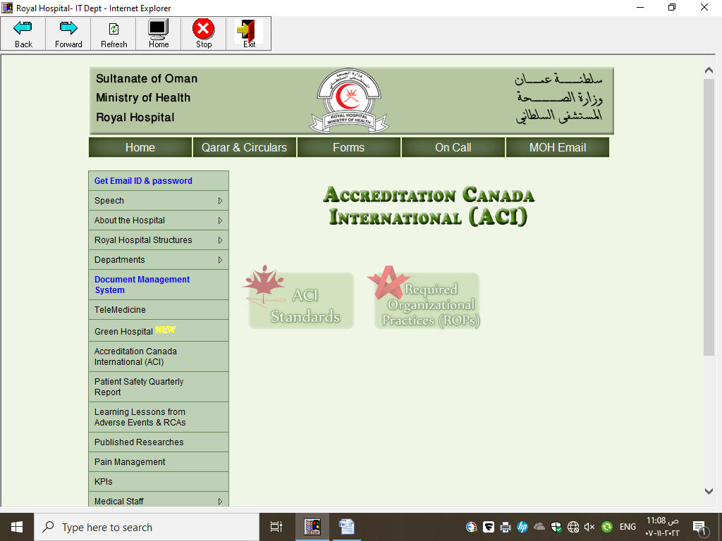

Slide 5
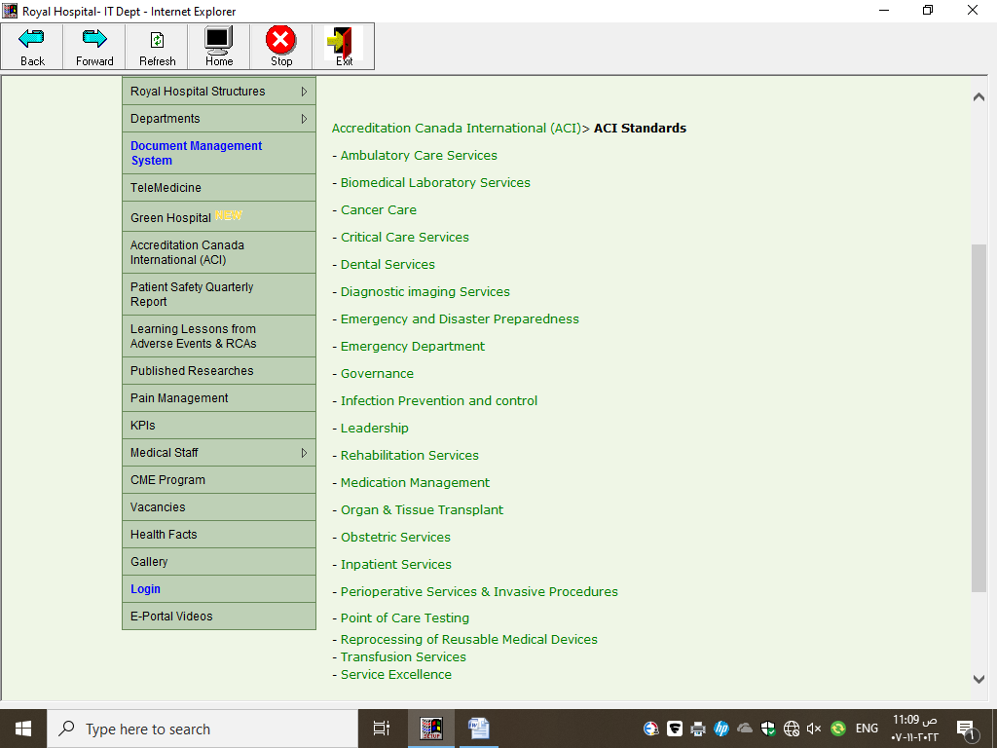
List of Department ACI Standards

Slide 6
Required Organizational Practices (ROPs)

Slide 7
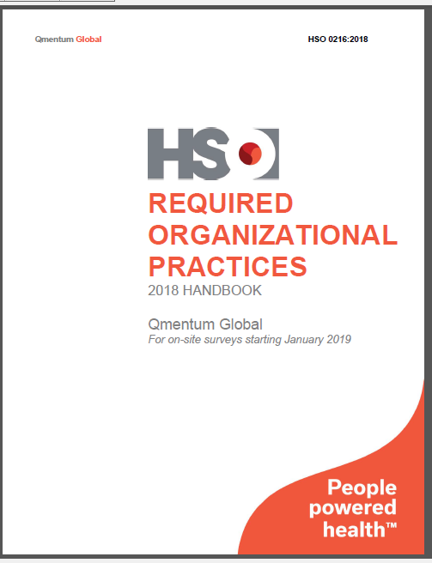
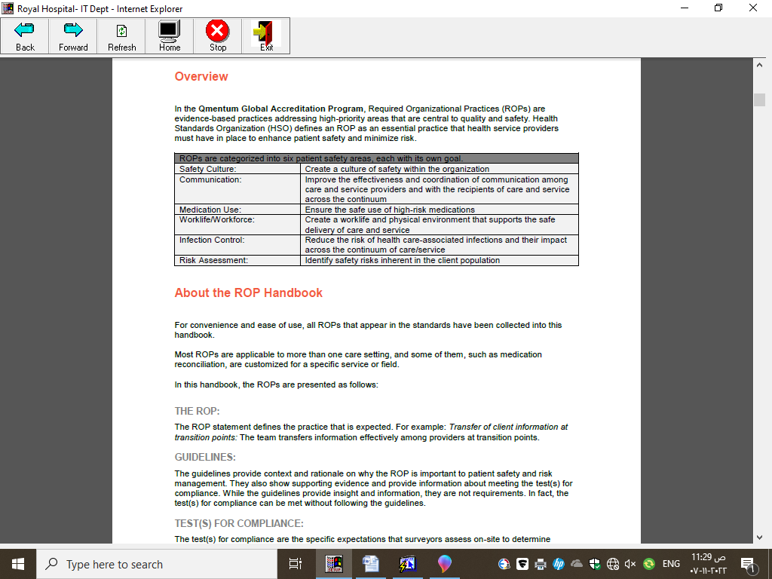
Required Organizational Practices

Slide 8
Required Organizational Practices
Required Organizational Practices (ROPs) are evidence-based practices that are central to quality and safety.
They are classified into 6 patient safety areas, each with its own goal.

Slide 9
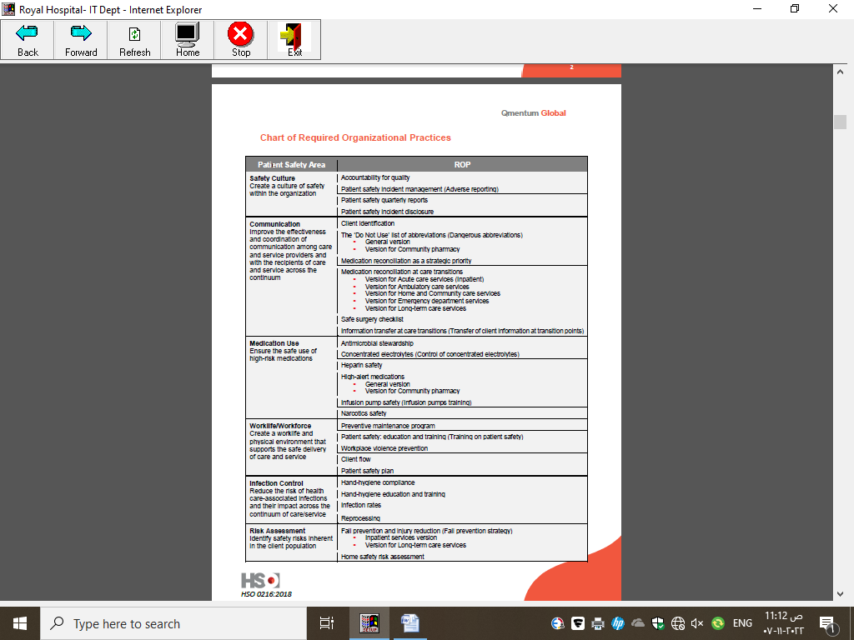
Patient Safety Area & ROPs

Slide 10
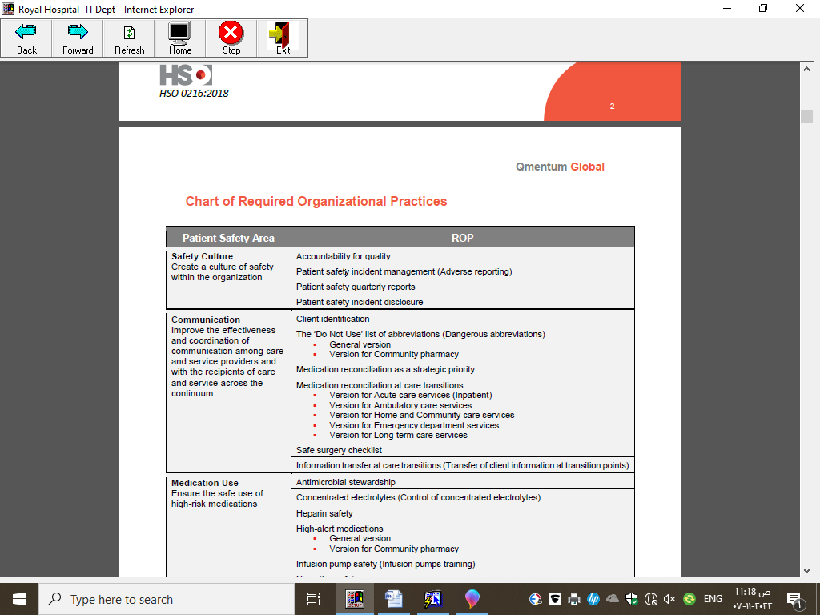
Area 1- Safety Culture

Slide 11
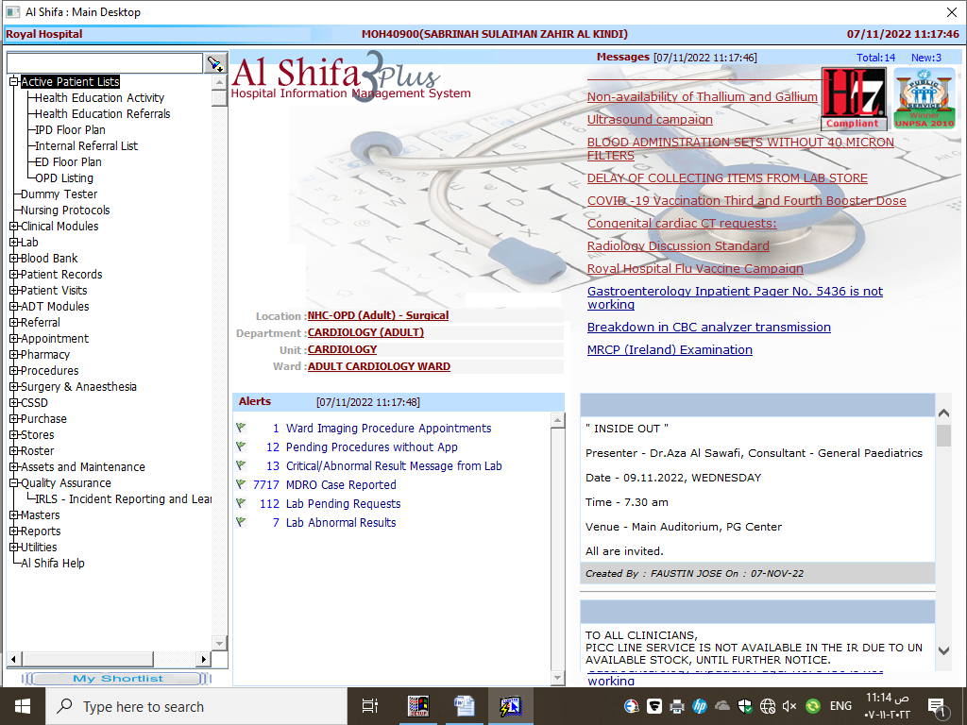
Patient Safety Incident Management

Slide 12
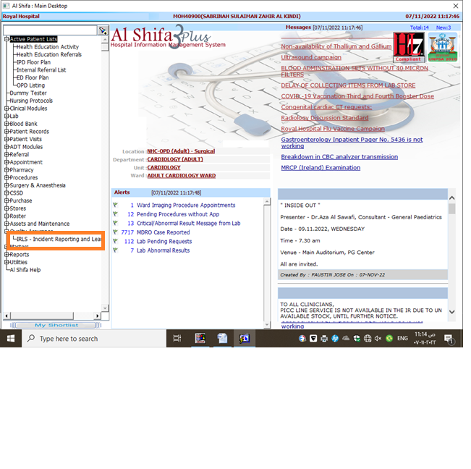
Patient Safety Incident Management

Slide 13
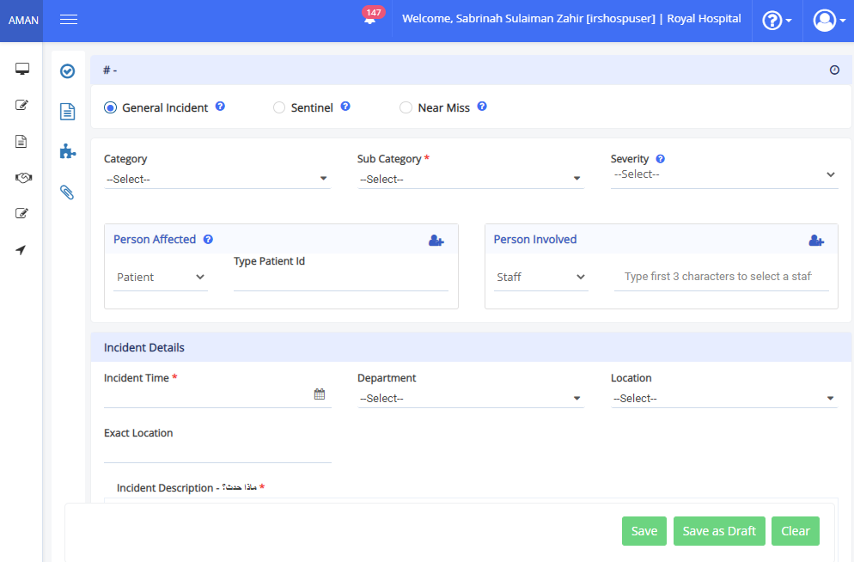

Slide 14
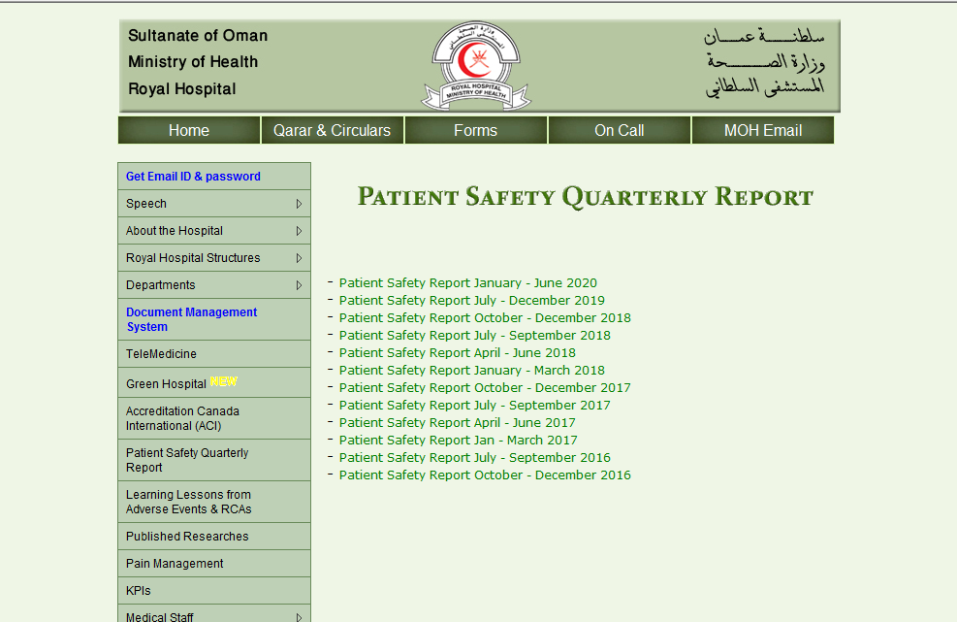
Patient Safety Quarterly Reports

Slide 15
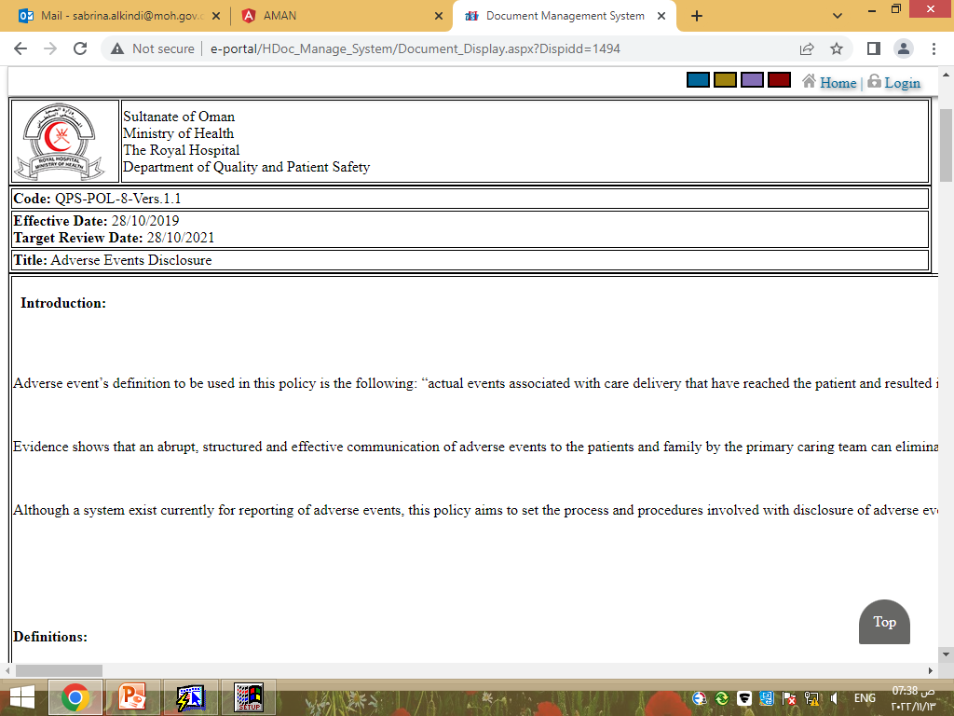
Patient Safety Incident Disclosure

Slide 16

Area 2 - Communication

Slide 17
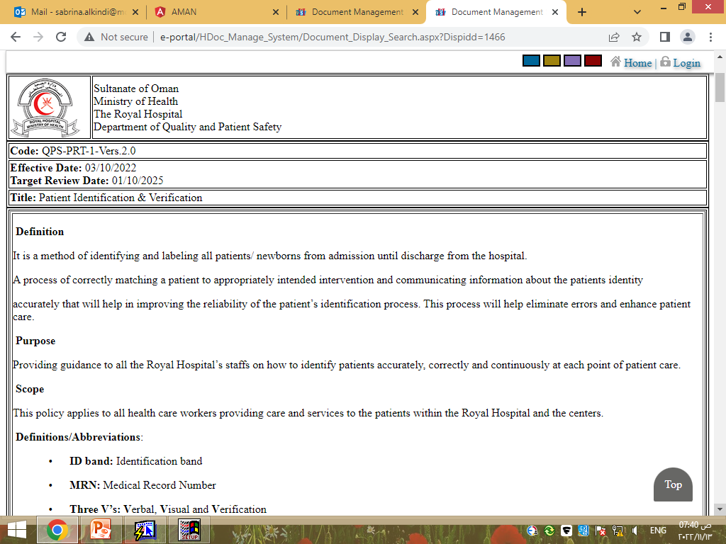
Client Identification
Policy (Hospital Management System Hospital Document QPS Patient Identification & Verification

Slide 18
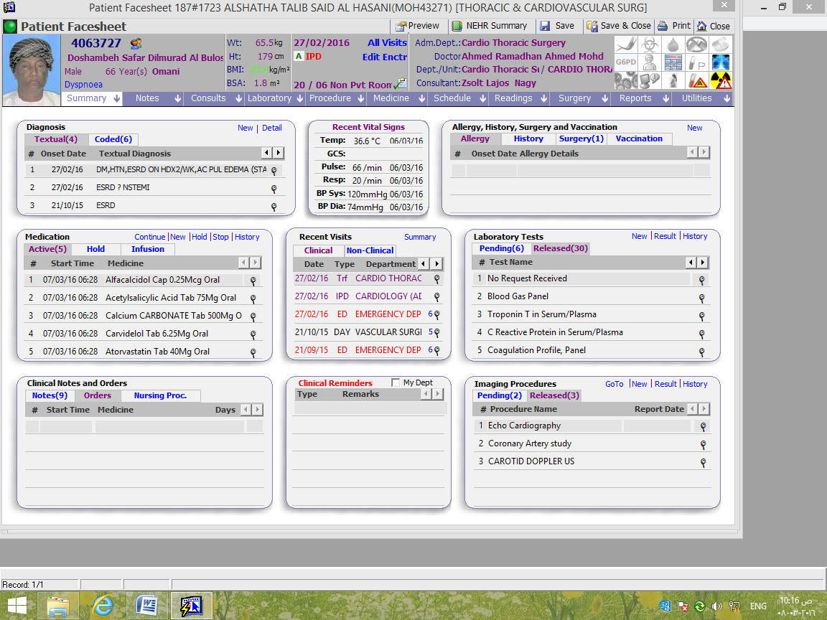
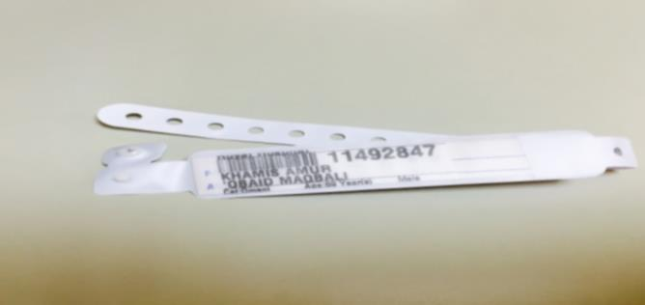

Client Identification (3 Vs)

Slide 19
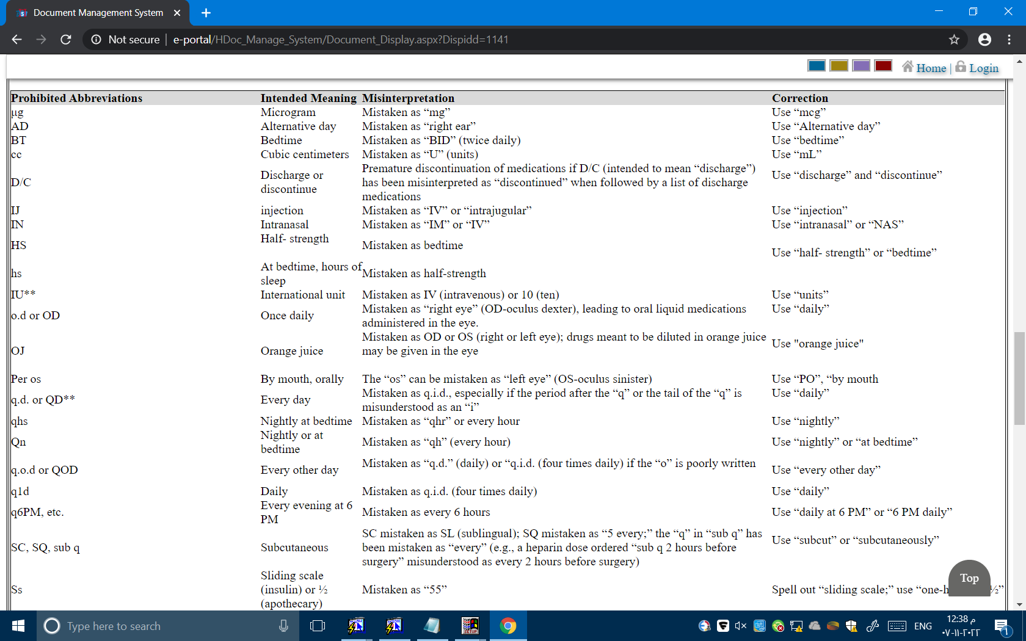
Dangerous Abbreviation

Slide 20
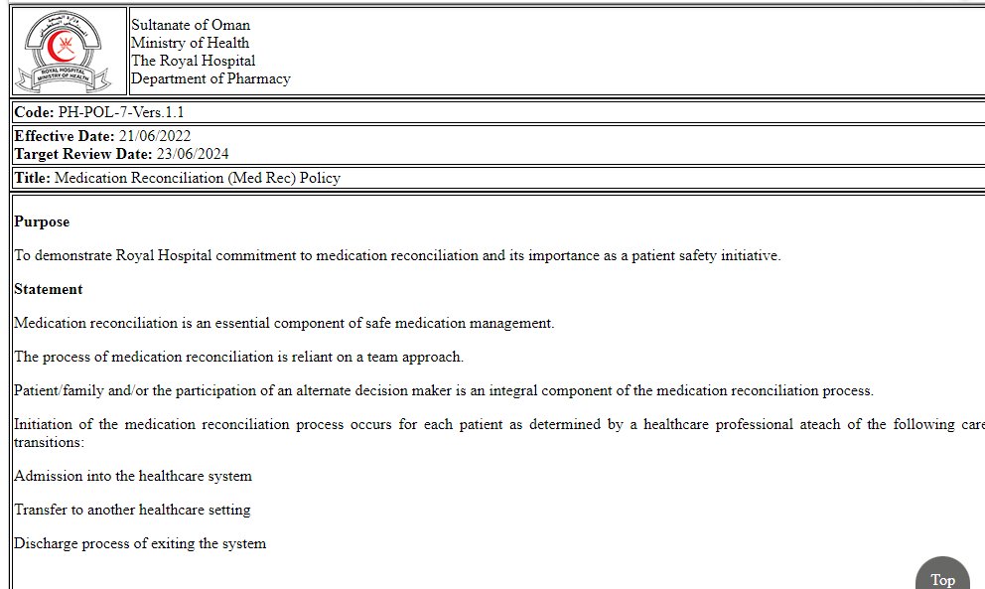
Medication Reconciliation
Policy (Hospital Management System Hospital Document PH Medication Reconciliation

Slide 21
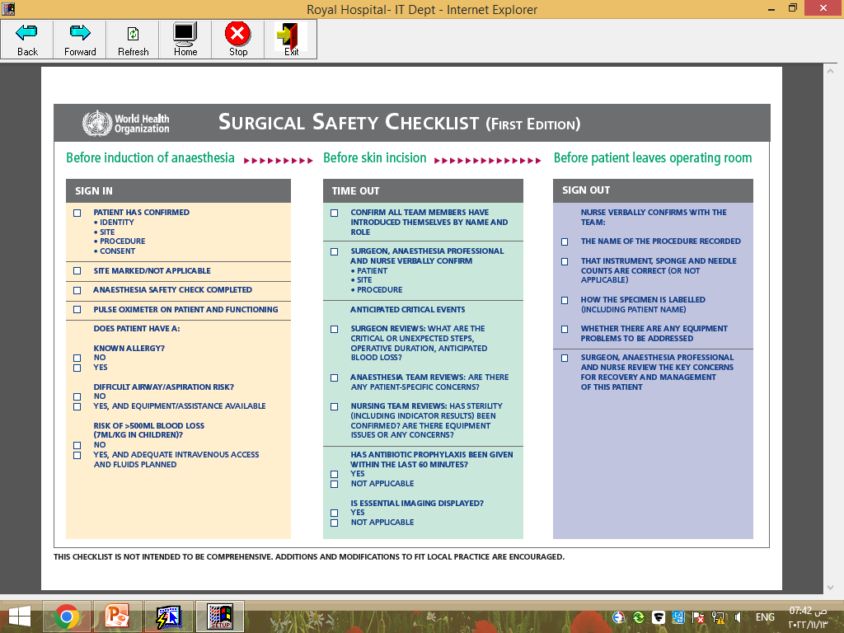
Safe Surgical Checklist

Slide 22
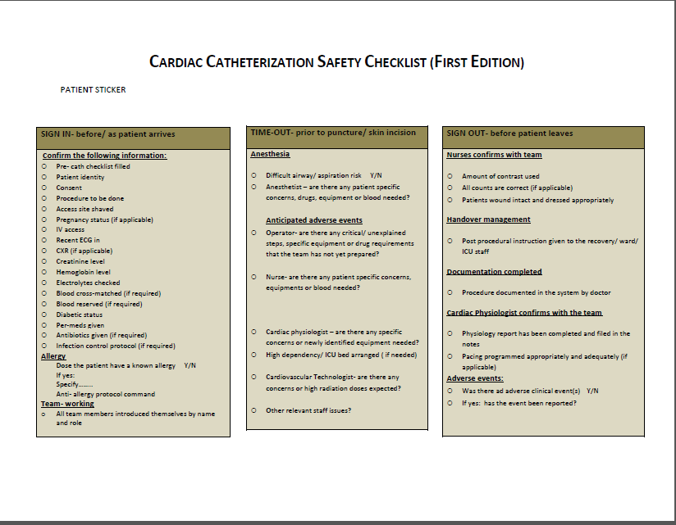

Slide 23
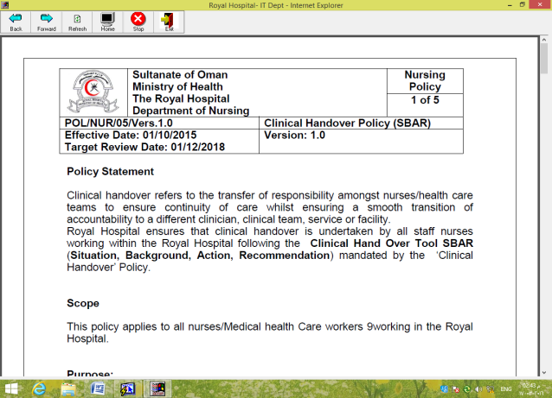
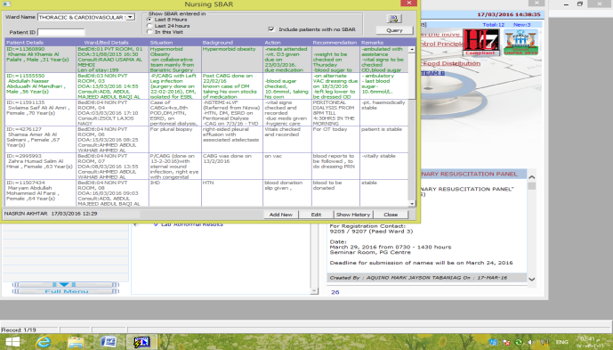
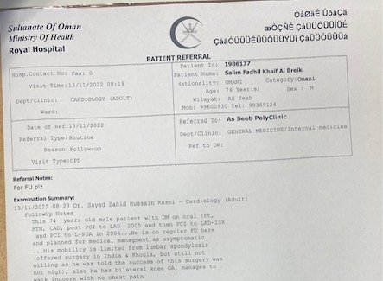
Information of Transition of Care

Slide 24
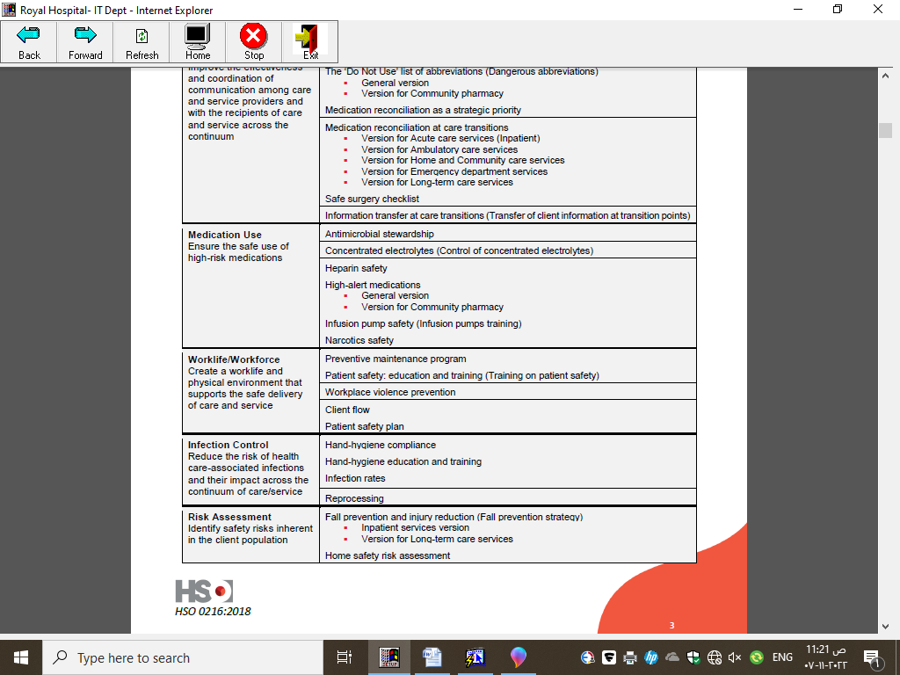
Area 3- Medication Use

Slide 25
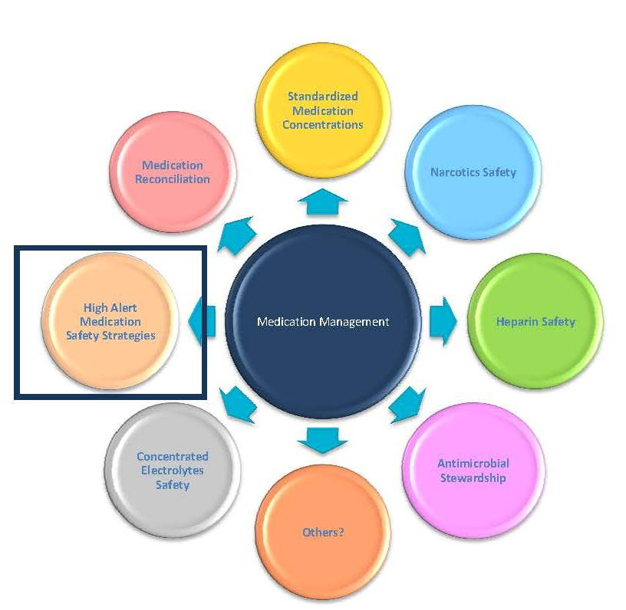

Slide 26
High -alert medication
STANDERD
Implements Strategy for management of high alert medication

Slide 27
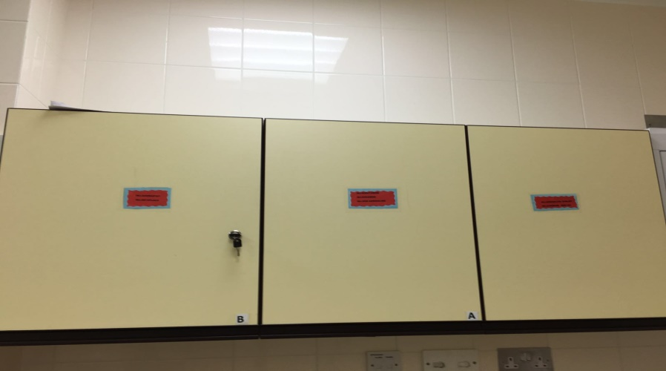
High -alert medication
Limiting access to high-alert (under lock)
Each shift checking medication and documented in the book (Narcotic )

Slide 28
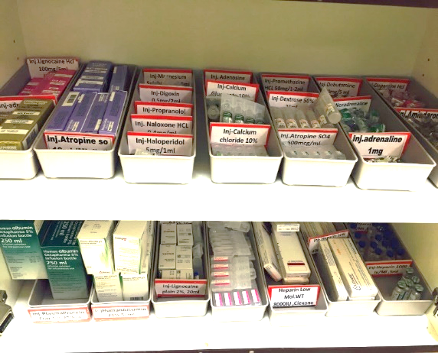
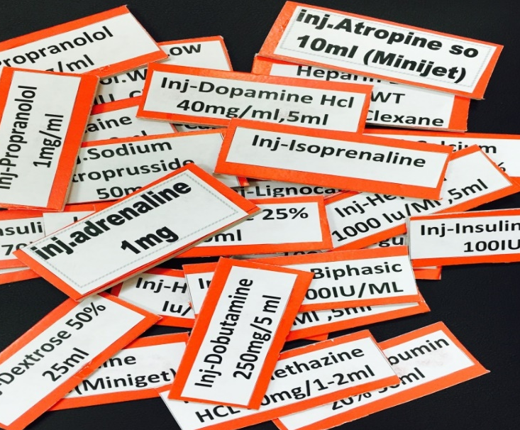
High -alert Medication
Applying label
( visible) red label
List of high alert medication kept on the unit

Slide 29

High -alert Medication
Pharmacists doing round and audit
( there is a communication book )

Slide 30

Area 4- Worklife/ Workforce

Slide 31
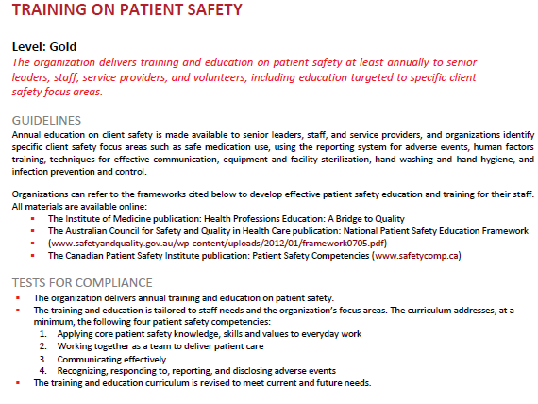

Slide 32
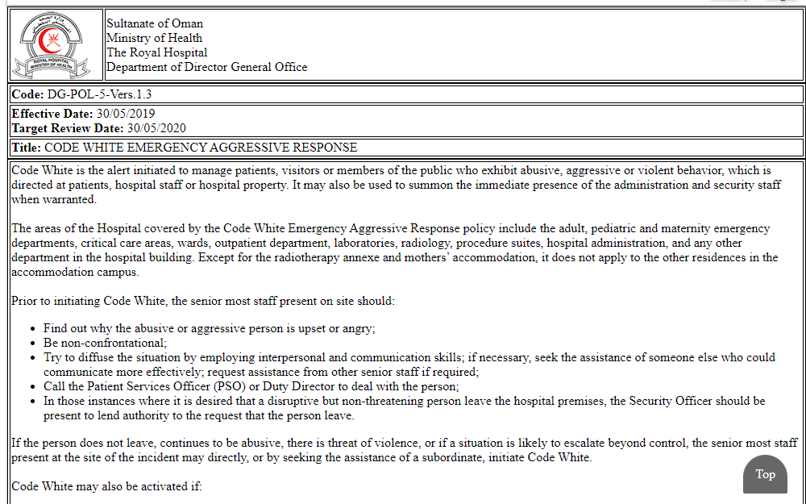
Workplace Violence Prevention
Policy (Hospital Management System Hospital Document DG Code White Emergency Aggressive Response

Slide 33

Area 5- Infection Control

Slide 34
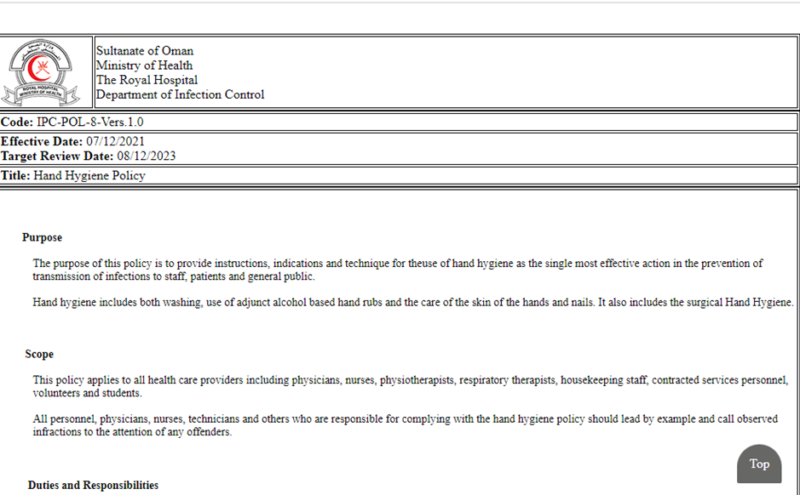
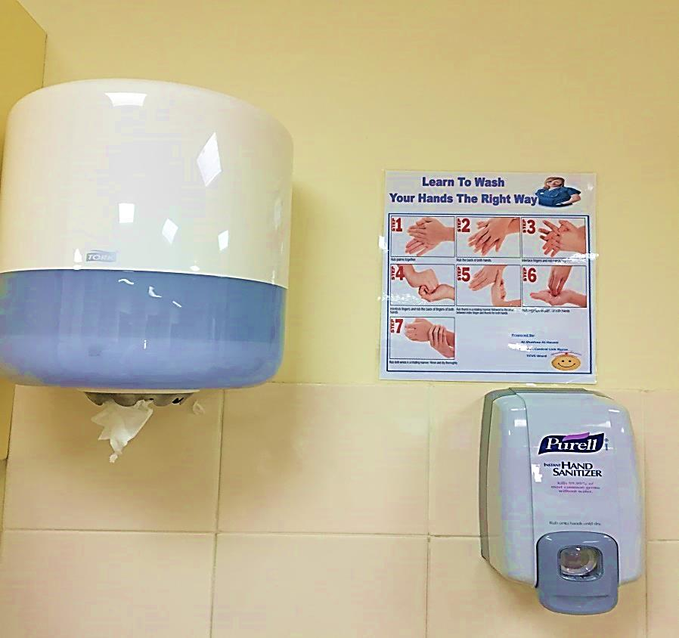
Hand Hygiene Compliance
Policy (Hospital Management System Hospital Document IPC Hand Hygiene Policy

Slide 35
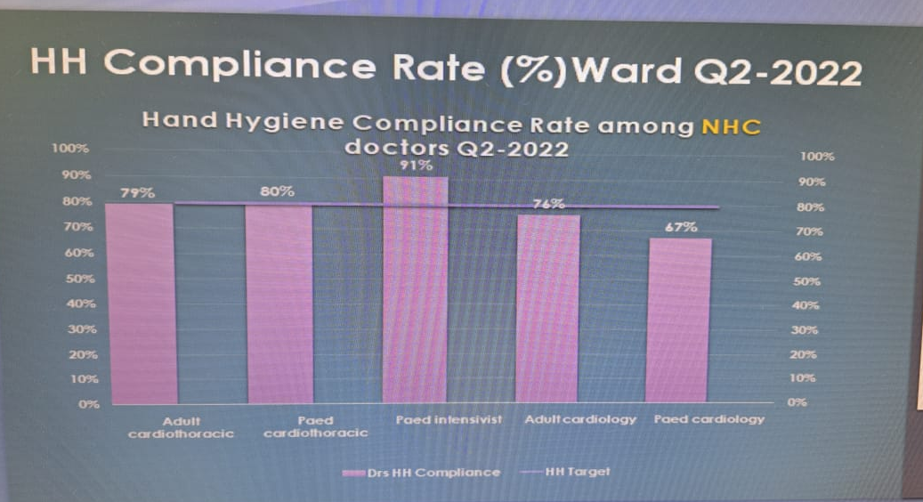
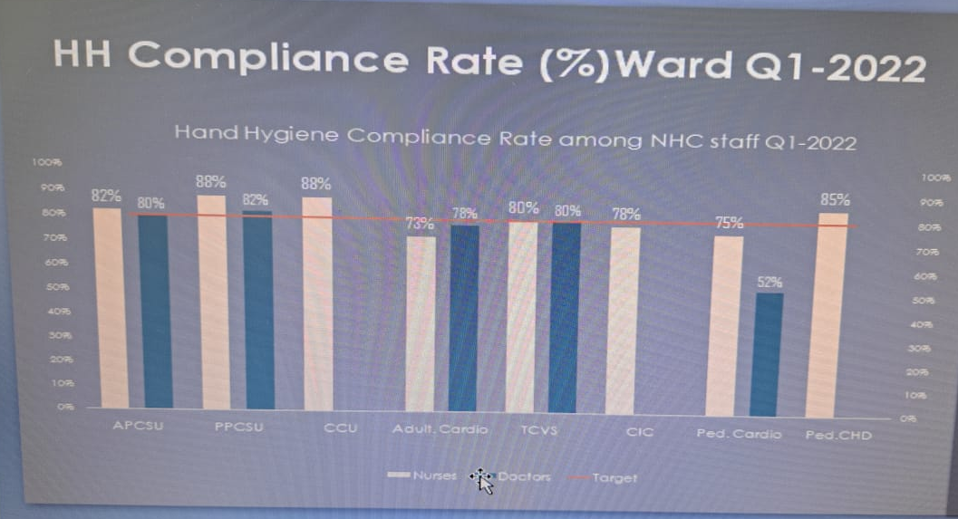
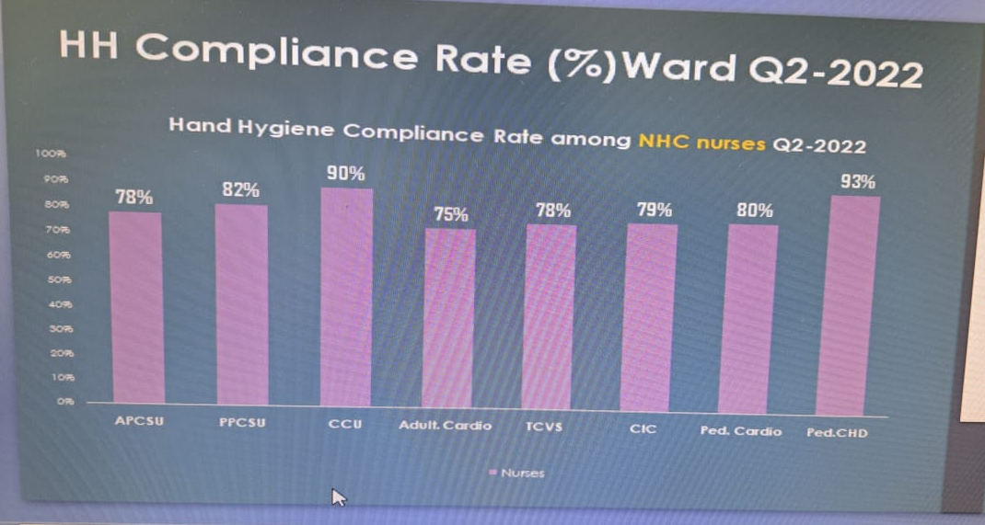
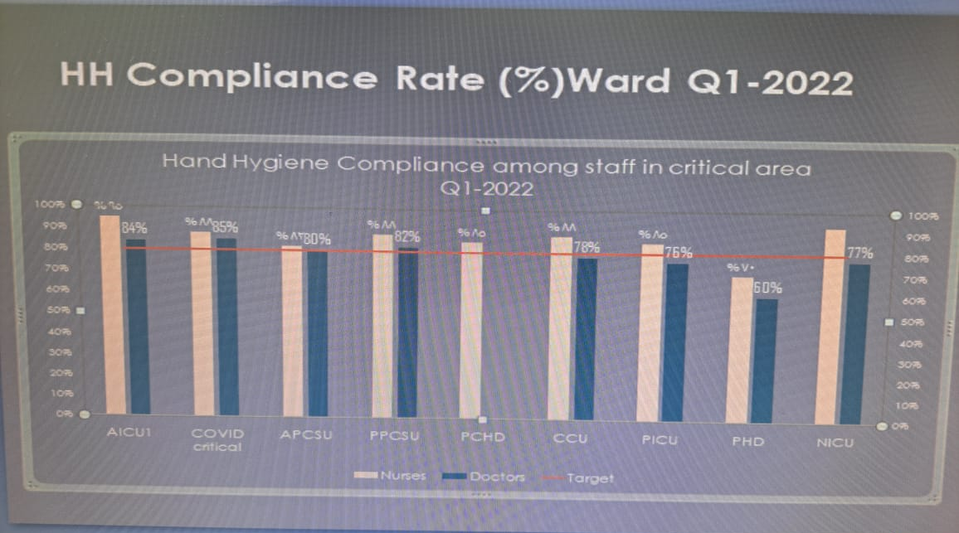
Hand Hygiene Compliance

Slide 36


Hand Hygiene Education
Infection Control Course(Royal Hospital/OMSB)
Hand Hygiene Awareness Day

Slide 37
Reprocessing
Monitoring of the sterilization process
Monitoring of sterilization process by observing the gauges or displays on the sterilizer. The external and internal indicators are the key points to assess the sterilization technique.
External indicators are used when the internal indicators cannot be seen from outside the package, such as:

Slide 38


The dark lines indicates that the set is sterilized
Before
After

Slide 39
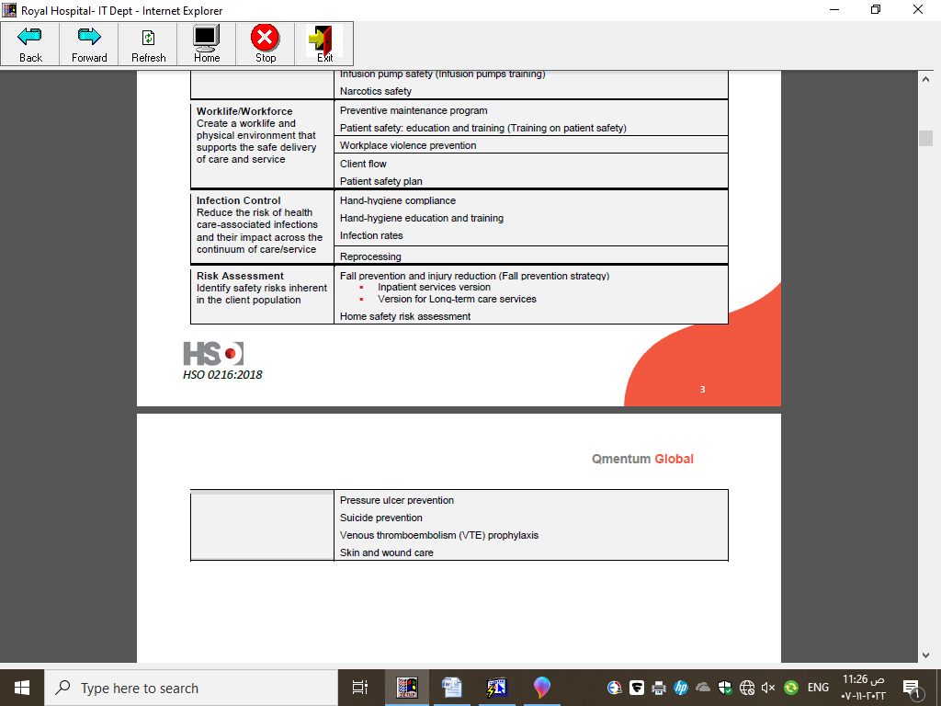
Area 6- Risk Assessment

Slide 40
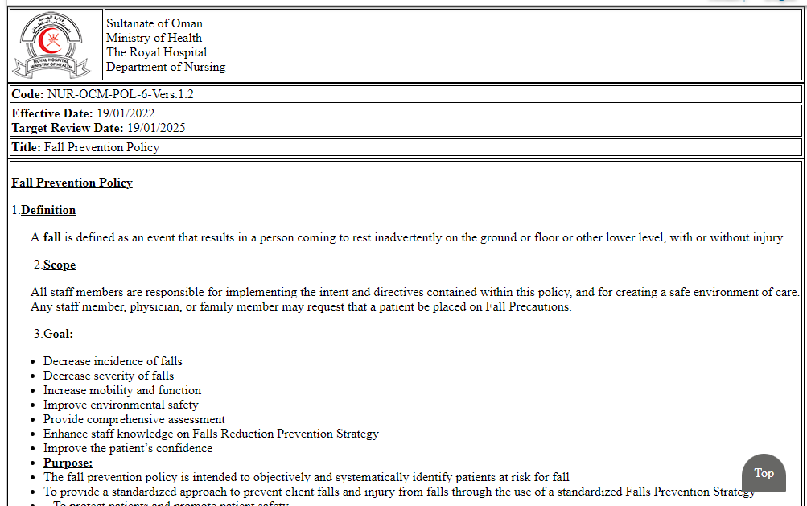
Fall Prevention Strategy
Policy (Hospital Management System Hospital Document Nursing Fall Prevention

Slide 41
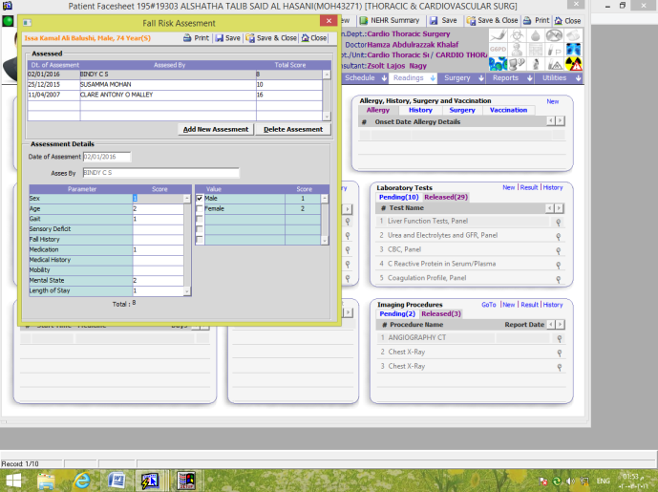

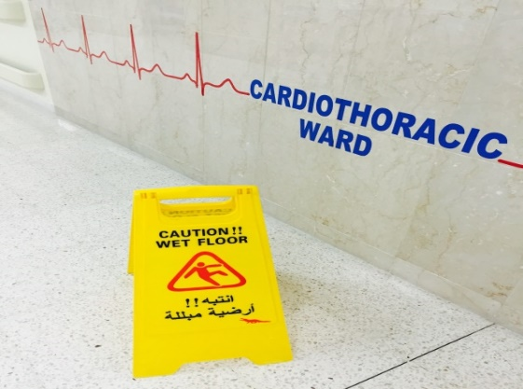
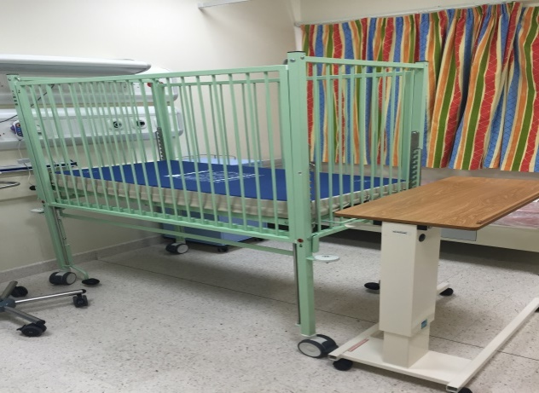
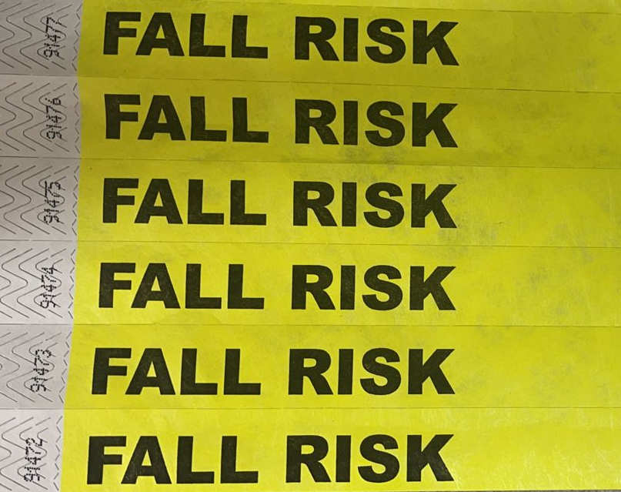
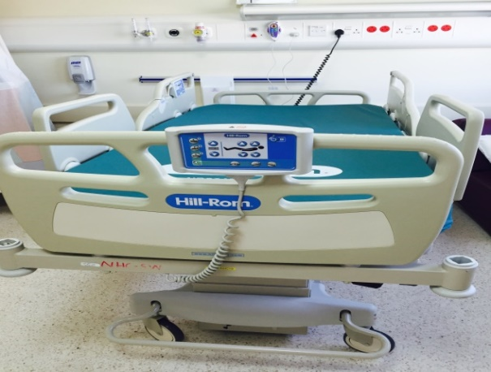
How to Prevent Fall

Slide 42
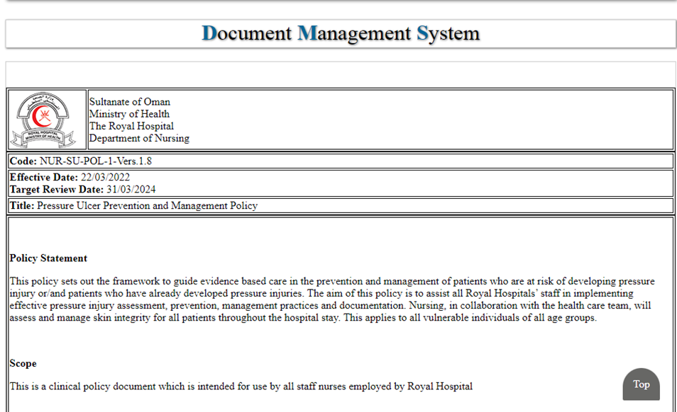
Pressure Ulcer Prevention & Skin and Wound Care
Policy (Hospital Management System Hospital Document Nursing Pressure Ulcer

Slide 43
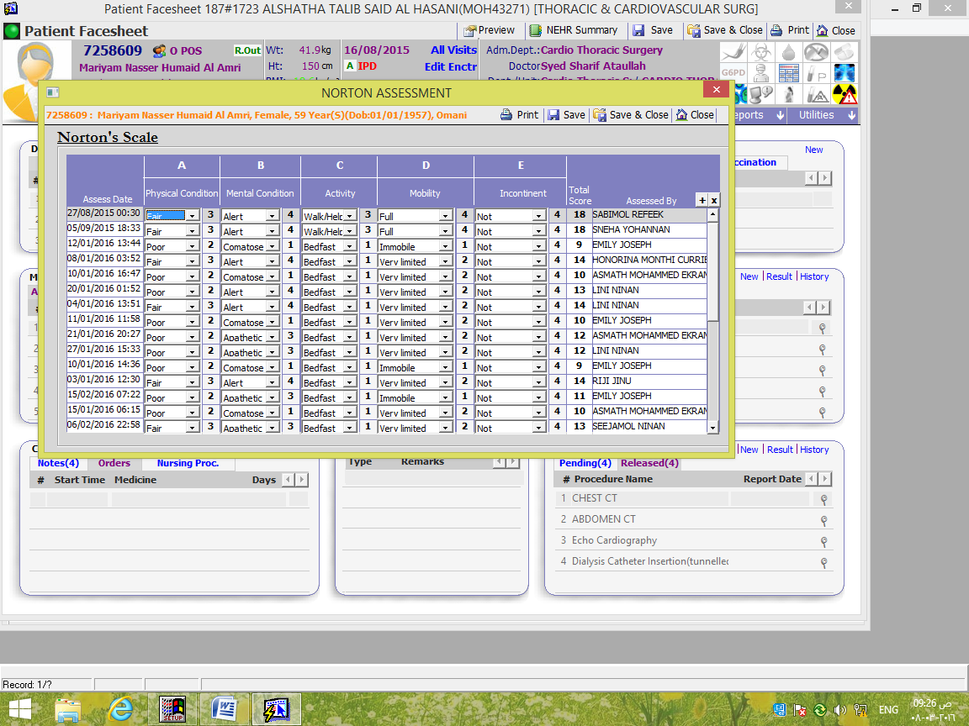

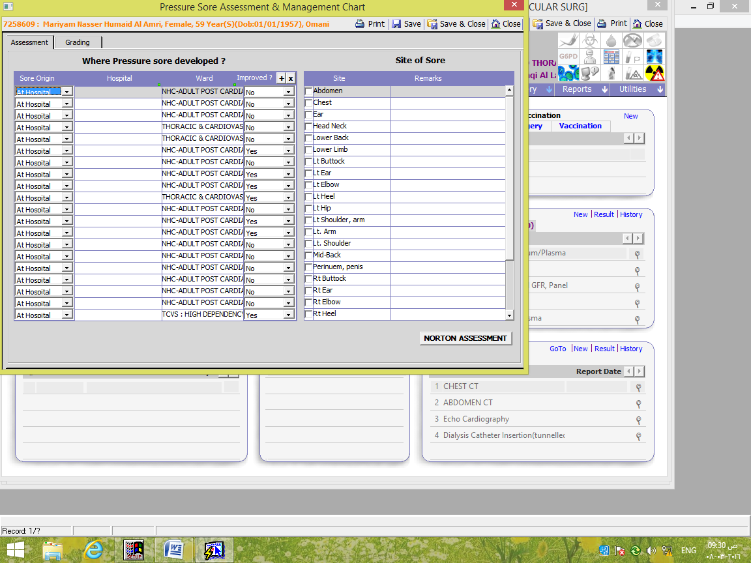
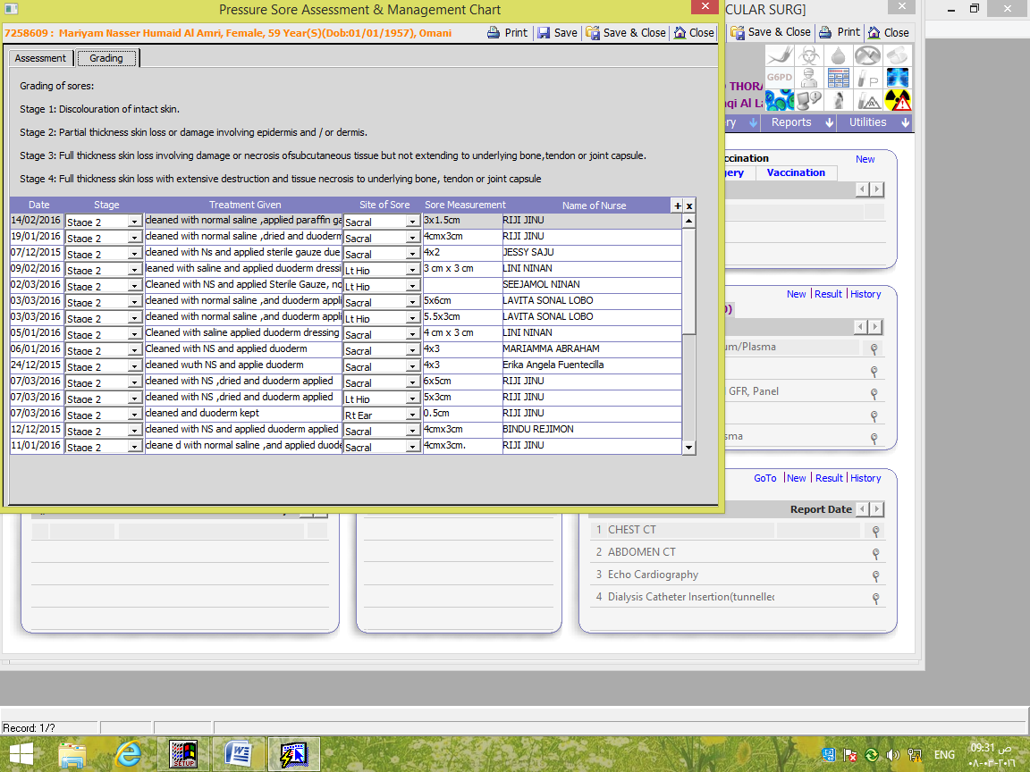
Pressure Ulcer Prevention & Skin and Wound Care

Slide 44
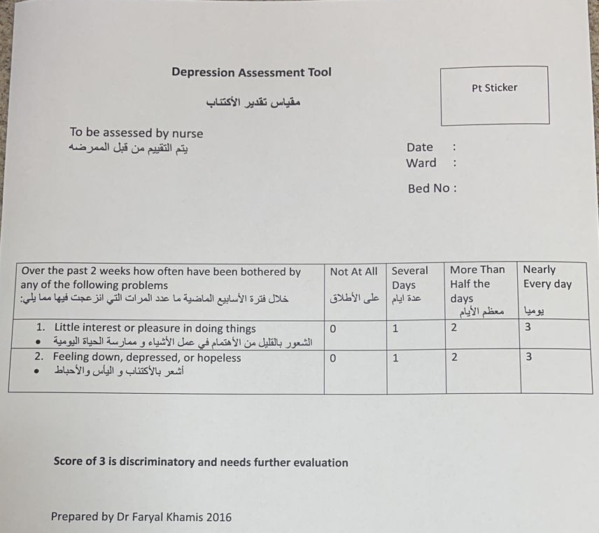
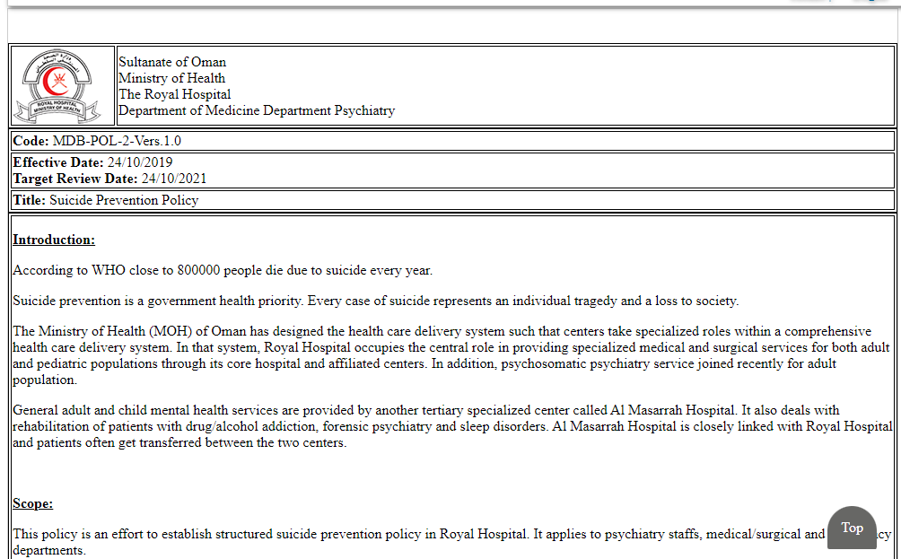
Suicide Prevention
Policy (Hospital Management System Hospital Document MDP Suicide Prevention

Slide 45
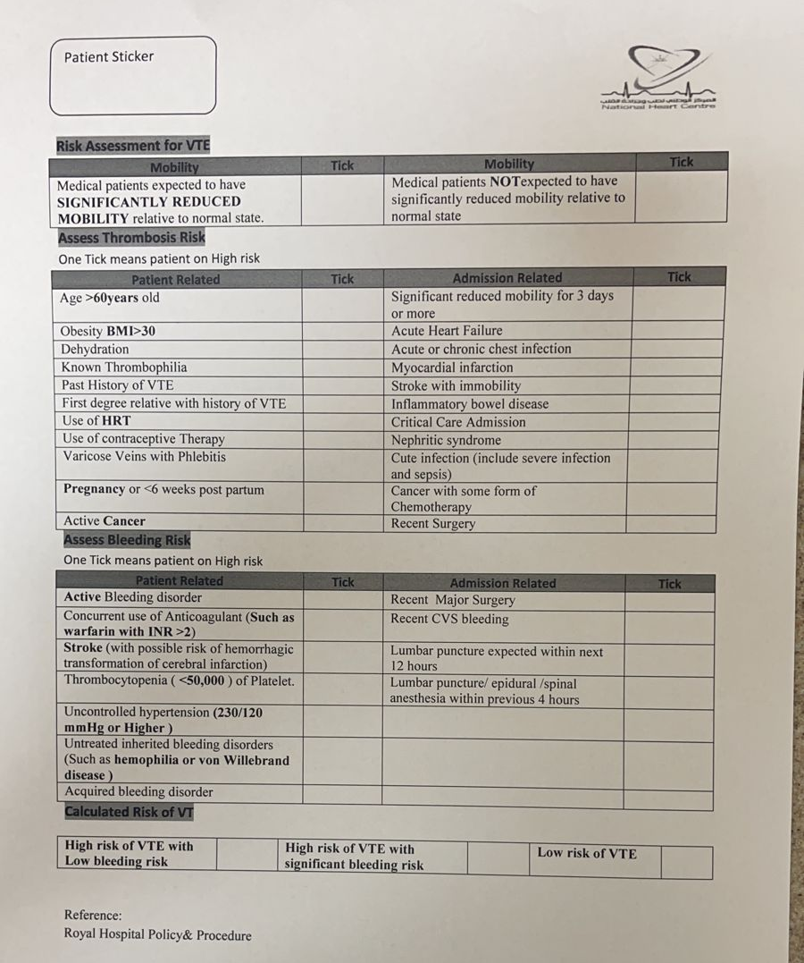
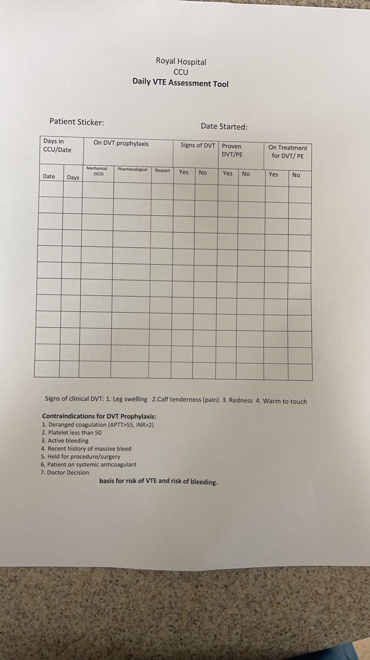
Venous Thromboembolism (VTE)

Slide 46

Vision and Mission

Slide 47
Next Plan
Distributing Videos Related to ROPs.
Continuing Audit.
Rapid Quiz.

